Slide 1
MSc Object Oriented Programming with C# and .NET
Lecture 11 – Files and Streams

Slide 2
Purpose of Files
Provides persistent storage for objects
Provides storage for large amounts of data
Provides flexible data storage – user has full control
Can store and retrieve text (formatted) or binary (unformatted data)
Uses streams – also basis for networking…

Slide 3
File structures
Data Hierarchy:
  Gets more complex as you move along:
    Bit: either one or zero
      All data represented as combination of bits
      Easy for electronic devices to understand
    Byte: eight bits – ascii files – UTF-8
    Character: in C# two bytes (unicode)
      Character set: set of all characters used to program and represent data on a particular computer
    Field: composition of characters that convey a meaning
    Record: composition of several, related fields
    File: group of related records
      Record key: identifies record to a particular entity
      Sequential file: records stored in order of record-key

Slide 4
Data Hierarchy
Sally
Black
Tom
Blue
Judy
Green
file
Iris
Orange
Randy
Red
Judy
Green
record
Judy
Field
Note:
With sequential files, individual records can be of unequal length. -
01001010 byte (ASCII for J)
1 bit

Slide 5
File class
Provides basic access to file structures
Has useful methods that –
Creates new files
Appends to an existing file
Opens in read or write modes – binary or text
Checks for the existence of a file

Slide 6
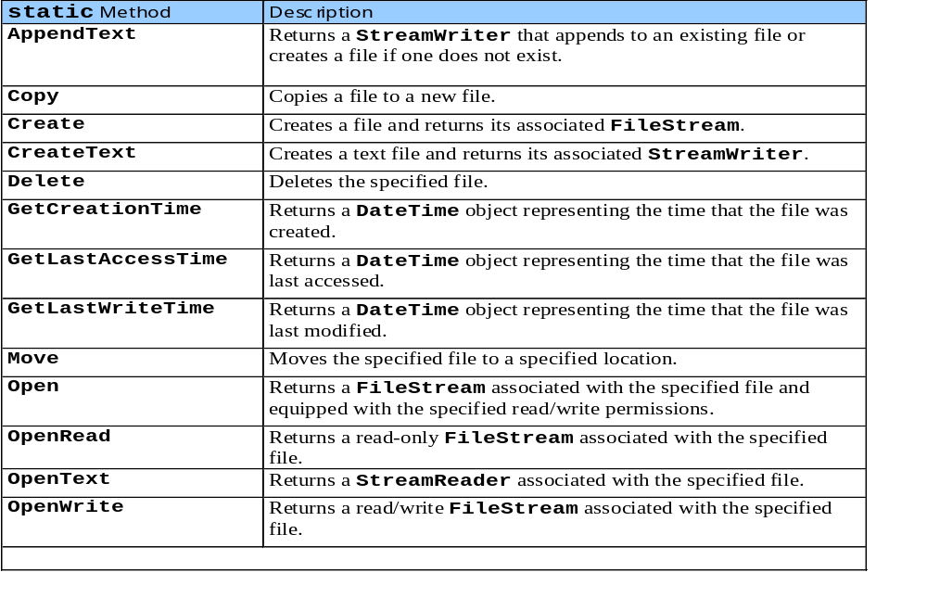
Some File methods

Slide 7
Files work with Streams
There is one basic (i.e. base) class for streams – these are the lowest level mechanism for reading and writing data to devices (e.g. keyboards, screens, files, network sockets, comms ports).
Stream, in C#, is an abstract base class that supports reading and writing of bytes… (but we can’t instantiate one of these)
Stream handles byte data

Slide 8
C# Streams
2 major sets of stream classes
Byte streams – read/write individual bytes
  Corresponds to physical data – network and disk I/O streams
  Low-level
Character streams – 2-byte Unicode characters
  Primary text input/output stream classes

Slide 9
Basic Abstract stream classes
Byte stream: Stream
Character streams: TextReader, TextWriter

Slide 10
File I/O
Idea: Create an object that manages the file stream
  Member functions support input and output operations
  Files normally opened when these objects are created
  Close files explicitly when done to be sure things terminate cleanly
Basic classes
  FileStream derived from Stream
  StreamReader derived from TextReader
  StreamWriter derived from TextWriter

Slide 11
So, what do we do?
We use a derived class:
StreamWriter, writes characters to a Stream, using Encoding to convert characters from raw bytes.
File, or FileStream
Stream – of unformatted bytes
StreamWriter
Stream of formatted or encoded bytes
To disk

Slide 12
C# programming example
File.CreateText method returns a StreamWriter object.
StreamWriter fWriter =
File.CreateText("C:\\limerick.txt");
fWriter.WriteLine("That Computing is first about coding,");
fWriter.WriteLine("Is a thought that I find simply foreboding.");
fWriter.WriteLine("They should be taught instead");
fWriter.WriteLine("About using their head");
fWriter.WriteLine("or in ten years their careers will be folding");
fWriter.Close();

Slide 13
Points
New line characters will be added
Lines will be of unequal length
Impossible to find a particular record other than by reading the file from beginning
Most readable of all file types

Slide 14
Reading from sequential text files
try
{
StreamReader s = File.OpenText("c:\\limerick.txt");
do
{
string line = s.ReadLine();
if (line == null) break;
textBox1.Text += line;
// Note, we could have used
// textBox1 += s.ReadToEnd();
} while (true);
textBox1.Text += "\n\n\n End";
}
catch (FileNotFoundException)
{
MessageBox.Show("Error", "Cannot find limerick.txt");
}
catch (IOException ie)
{
MessageBox.Show("Error", "IO exception");
}
}
Program reads a line at a time and adds to a text box textbox1 on a form

Slide 15
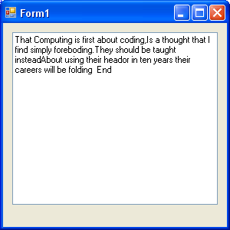

Slide 16
Notes about text files
No concept of 'records' actually exists
Programmer has to use special characters to insert new lines, separate items etc
Less efficient storage
Most portable form of data storage
Any program can read in text files without prior knowledge of contents.

Slide 17
Binary files
Binary files don't format data
Use instead Binary or Serializable forms of saving file
This allows 'direct access' of a particular record
Generally all records are of the same length
Allows any object to be saved or read back

Slide 18
E.g.
[Serializable]
class Person
{
string name;
public Person(string name)
{
this.name = name;
}
public string Name
{
set
{
name = value;
}
get
{
return name;
}
}
}
}

